Slide 1
BILATERAL FILTER IN
DIGITAL IMAGES PROCESSING
Notes:
Today I’ll be presenting on FUNDAMENTALS OF SPACTIAL FILLTERING
– a fundamental technique used to enhance image quality before deeper analysis.

Slide 2



GAUSSIAN FILTER KERNEL
Original Image
Gaussian Kernel 25x25 sigma = 2.0
Gaussian Kernel 25x25 sigma = 5.0
Notes:
To reduce image noise, we often blur the image. One of the most common tools is the Gaussian kernel. In the example below, we can clearly see the effect of the Gaussian kernel in blurring and removing noise.
However, when we increase sigma — in order to enhance the blurring effect — the Gaussian filter also blurs the edges. This causes the image to lose important details. We can clearly see this in Image 3, where the edges are no longer sharp.
To overcome this drawback of Gaussian Blur, a more intelligent filter called the Bilateral Filter is used.

Slide 3
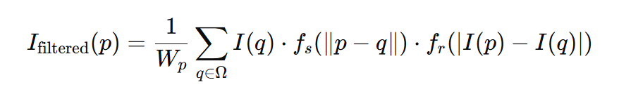
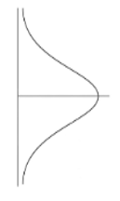
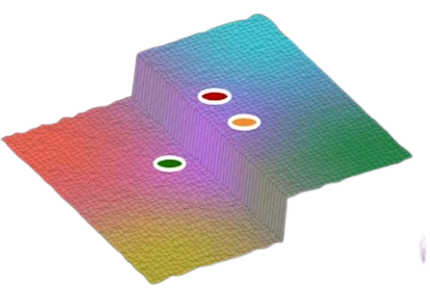
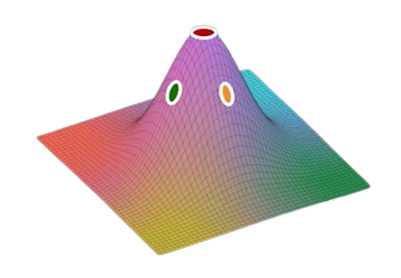
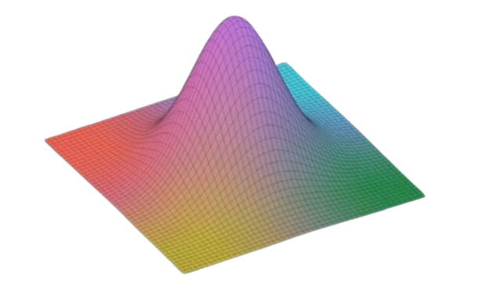
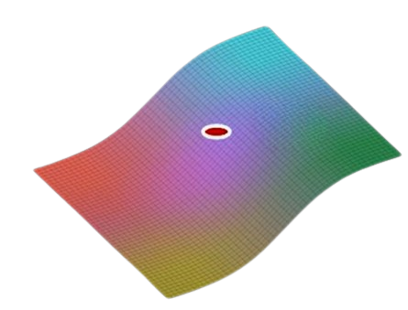
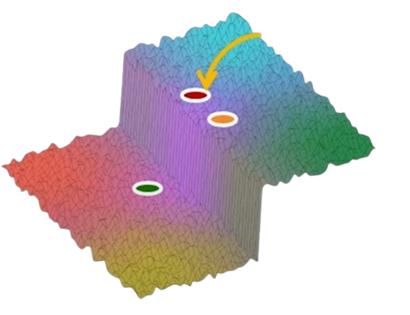
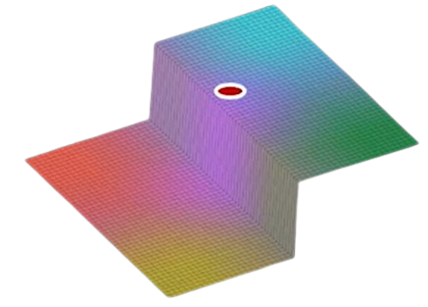
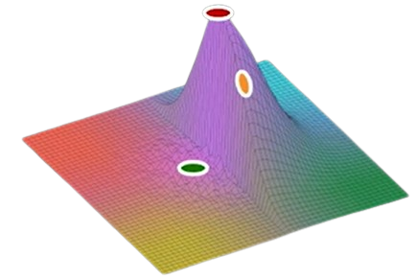
Bilateral Filter and Gaussian Filter
Spatial Gaussian
Brightness Gaussian
Intensity
weight
p
Multiply
Output
Input
Notes:
The expression shown here is just the convolution of an image with a spatial Gaussian; it is just Gaussian smoothing. Consider the section of the input image in the right corner It is a step edge that is corrupted by noise. We would like to remove the noise while preserving the edge. When the Gaussian filter is applied to the image patch with its center at the image pixel P, Lets Consider two points: one yellow and one green. The yellow point receives a high weight — because it is close to the center. That makes sense since it lies on the same side of the edge.
However, the green point you see here is also assigned a similar weight, even though it lies on the other side of the edge. This doesn’t make sense — and that’s exactly the problem we want to solve.
The effect of applying a Gaussian that is independent of the content around the pixel is that, while noise is reduced, the output image is blurred. On the left we see the output where the edge in the original image is washed out.

Slide 4
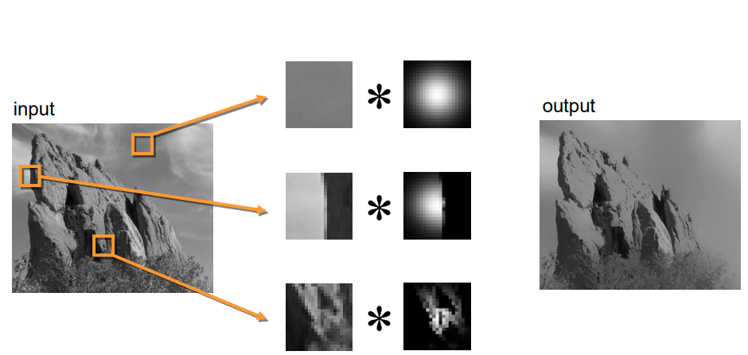
Bilateral Filter
Input
Bilateral Filter
Notes:
This example demonstrates how the shape of the kernel depends on the image content. The first row shows a constant area; the second row shows a step edge, as we discussed in the previous section; and the third row shows an input with an arbitrary shape.

Slide 5
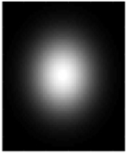
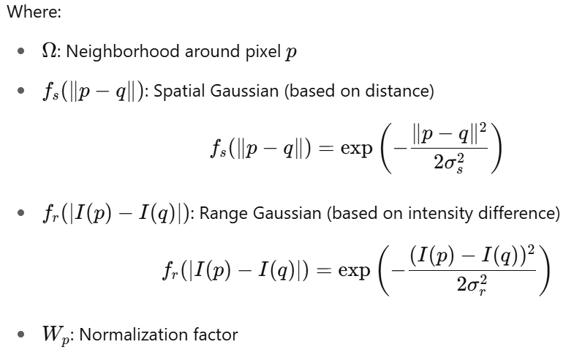
Mathematical Formula of Bilateral Filter
Spatial Gaussian
Brightness Gaussian
Intensity
weight

Slide 6
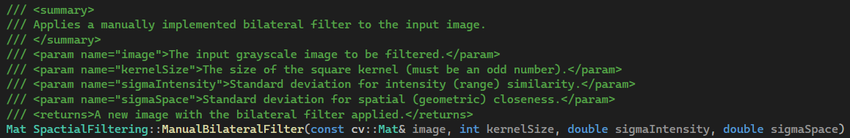
Program

Slide 7
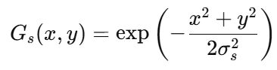
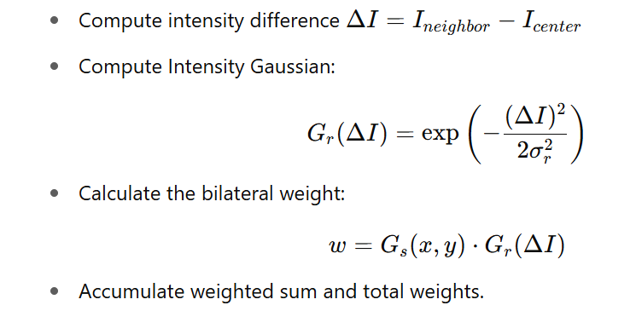
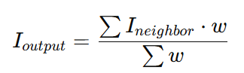
Program
Step 1: Initialization and padding the image
Step 2: Precompute Spatial Gaussian Kernel
Each weight depends on pixel's distance from center of the kernel.
This is fixed for all pixels, so computed once.
Step 3: Loop over every pixel in the image
For each pixel in the kernel window
Step 4: Normalize the result:
Step 5: Return the result image

Slide 8
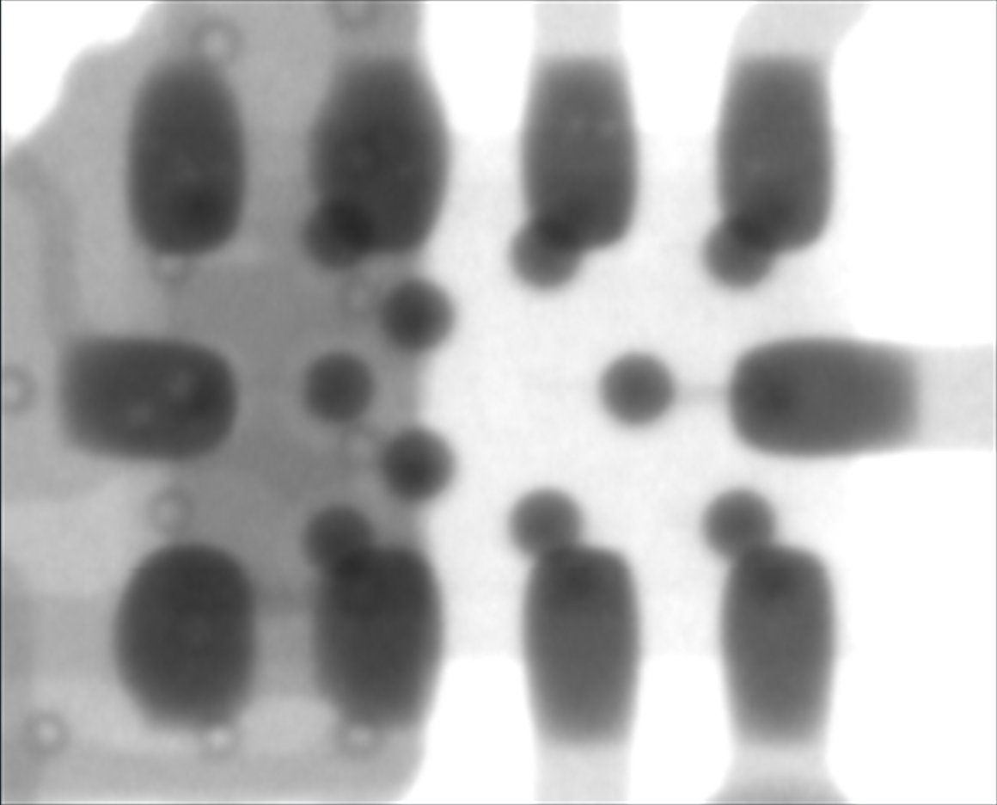
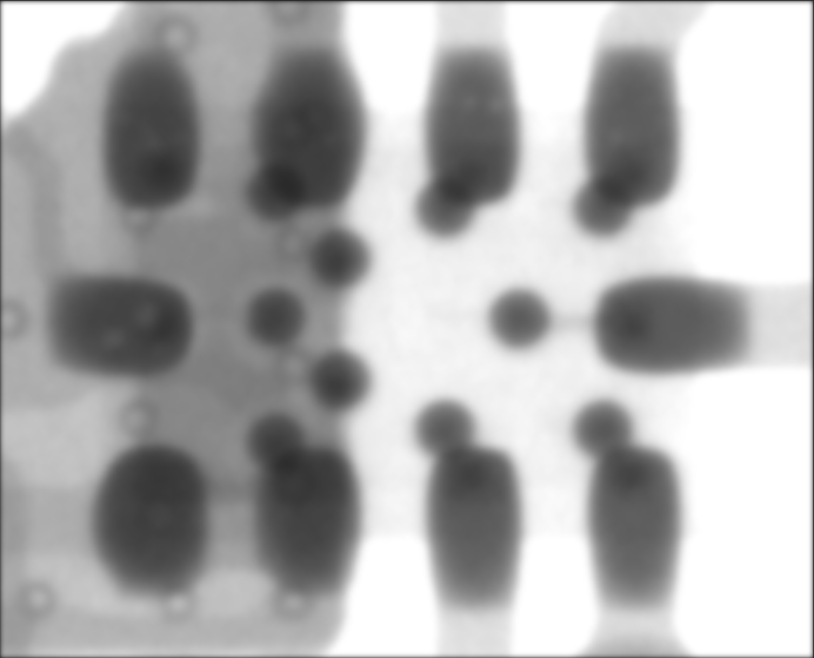



Original image
307x248 pixels
Gaussian filter 9x9
$$σ_{s}=1.0$$
Bilateral filter 9x9
$σ_{s}=1.0$, $σ_{r}=1.0$

Slide 9




Original image
307x248 pixels
Gaussian filter 9x9
$$σ_{s}=2.0$$
Bilateral filter 9x9
$σ_{s}=2.0$, $σ_{r}=1.0$

Slide 10
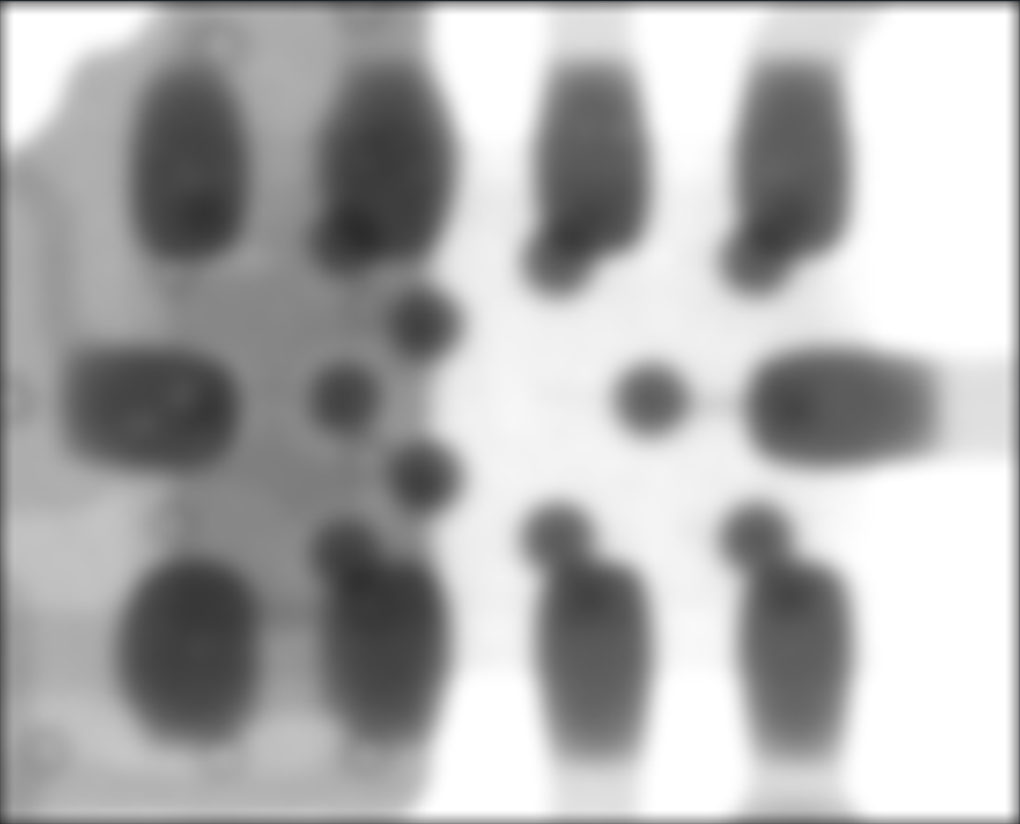



Original image
307x248 pixels
Gaussian filter 9x9
$$σ_{s}=3.0$$
Bilateral filter 9x9
$σ_{s}=3.0$, $σ_{r}=1.0$

Slide 11





Bilateral filter 9x9
$σ_{s}=3.0$, $σ_{r}=1.0$
Bilateral filter 9x9
$σ_{s}=3.0$, $σ_{r}=2.0$
Bilateral filter 9x9
$σ_{s}=3.0$, $σ_{r}=3.0$

Slide 12






Bilateral filter 9x9
$σ_{s}=3.0$, $σ_{r}=5.0$
Bilateral filter 9x9
$σ_{s}=3.0$, $σ_{r}=9.0$
Bilateral filter 9x9
$σ_{s}=3.0$, $σ_{r}=25.0$

Slide 13
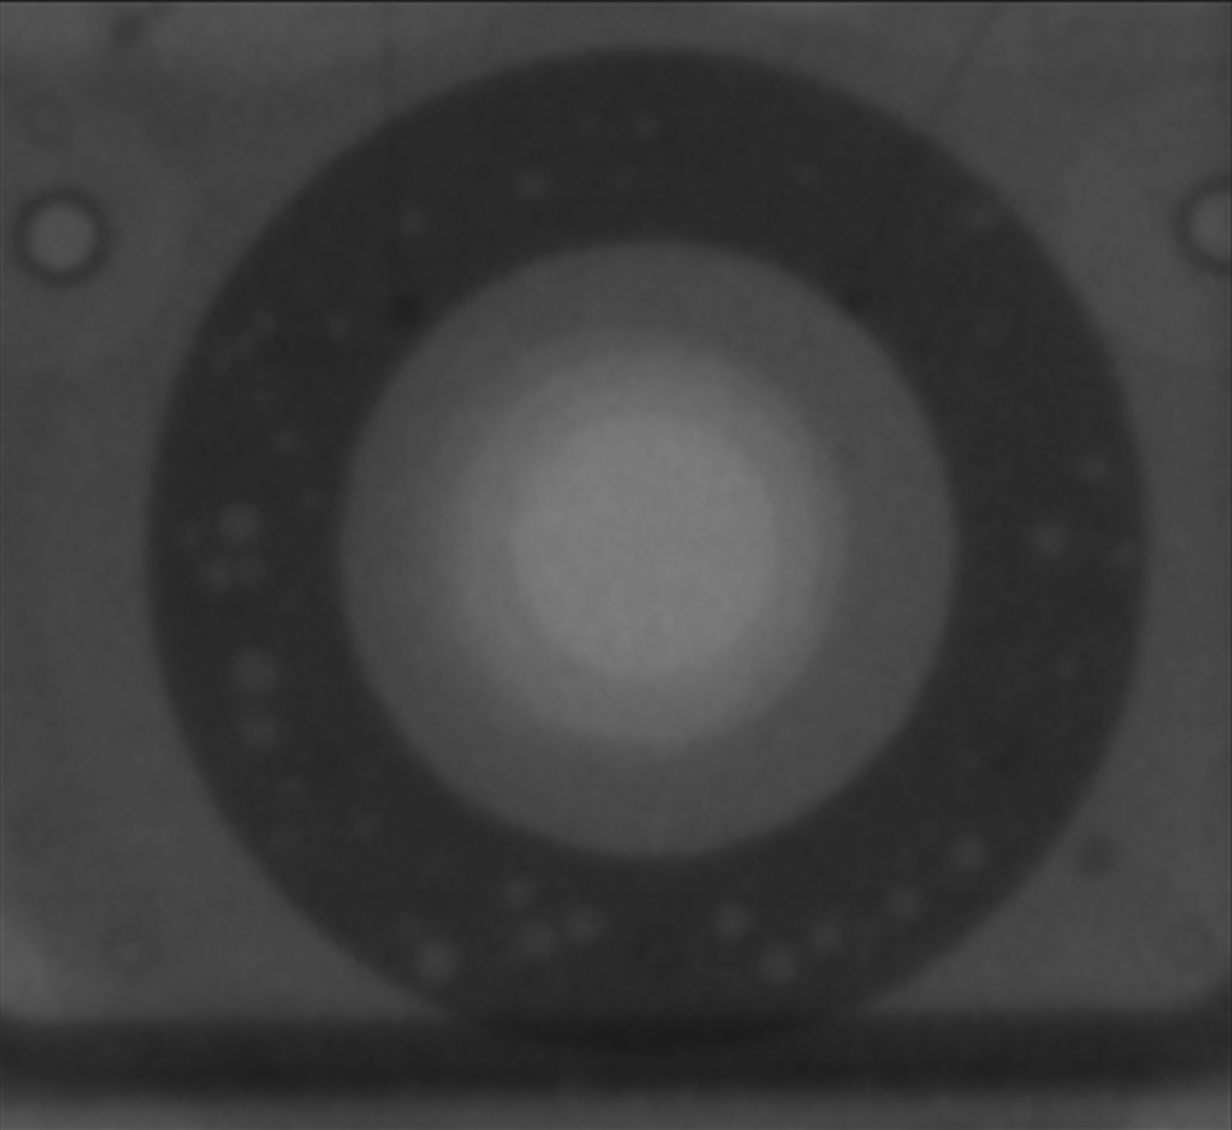




Result
Original image
349x320 pixels
Gaussian filter 9x9
$$σ_{s}=1.0$$
Bilateral filter 9x9
$σ_{s}=1.0$, $σ_{r}=1.0$
Notes:
Let’s take a look at how the bilateral filter perform on a image. The image on the left is the original one, which contains some visible noise. Our goal is to reduce this noise without losing important features of the image.
When applying a Gaussian filter with σ = 1, the result is a slightly blurred image, but the noise is not fully removed. This is because Gaussian filtering only considers spatial distance, so nearby noisy pixels still influence the result.
In the rightmost image, we apply a Bilateral Filter with σ<sub>s</sub> = 1.0 (same spatial influence as Gaussian), but with an added component σ<sub>r</sub> = 1.0, which considers intensity differences.
However, since both σs and σr are quite small, the filter barely performs any smoothing. That’s because most neighboring pixels are either too far in space or too different in intensity, and thus are excluded from the filtering process. As a result, the image looks almost unchanged compared to the original.

Slide 14




Result
Original image
349x320 pixels
Gaussian filter 9x9
$$σ_{s}=2.0$$
Bilateral filter 9x9
$σ_{s}=2.0$, $σ_{r}=1.0$
Notes:
"When increasing sigma space (σₛ) to 2, we observe that the Gaussian filter effectively removes almost all noise. However, this comes at the cost of blurred edges and lost fine details. In contrast, the bilateral filter preserves edges while reducing noise—though only partially, due to the small sigma range (σᵣ) value."

Slide 15




Result
Original image
349x320 pixels
Gaussian filter 9x9
$$σ_{s}=3.0$$
Bilateral filter 9x9
$σ_{s}=3.0$, $σ_{r}=1.0$

Slide 16



Result
Original image
349x320 pixels
Bilateral filter 9x9
$σ_{s}=3.0$, $σ_{r}=1.0$
Notes:
"Figure 4 shows a zoomed-in comparison of the original image (a) and the bilateral-filtered result (b). The results demonstrate partial noise suppression

Slide 17




Result
Gaussian filter 9x9
$$σ_{s}=10.0$$
Bilateral filter 9x9
$σ_{s}=10.0$, $σ_{r}=1.$
Original image
349x320 pixels
Notes:
"As sigma increases, the Gaussian filter's output shows progressive loss of minute details, including the fading visibility of white circular.

Slide 18





Result
Bilateral filter 9x9
$σ_{s}=3.0$, $σ_{r}=1.0$
Bilateral filter 9x9
$σ_{s}=3.0$, $σ_{r}=2.0$
Bilateral filter 9x9
$σ_{s}=3.0$, $σ_{r}=3.0$

Slide 19






Result
Bilateral filter 9x9
$σ_{s}=3.0$, $σ_{r}=9.0$
Bilateral filter 9x9
$σ_{s}=3.0$, $σ_{r}=15.0$
Bilateral filter 9x9
$σ_{s}=3.0$, $σ_{r}=25.0$
Notes:
Next, let’s take a look at how the result changes when we increase sigma r
When we increase sigma r, the range Gaussian function becomes wider. This means the filter becomes more tolerant to larger intensity differences between pixels.
As a result, the bilateral filter smooths the image more effectively, reducing noise while still preserving edges to some extent. The image appears cleaner and more visually pleasant, especially in areas affected by noise.
However, if sigma<sub>r</sub> is increased too much, the filter begins to treat pixels with significantly different intensities as similar. This leads to edge blurring, and the distinction between regions becomes less clear.
In extreme cases, the bilateral filter starts to behave like a regular Gaussian filter, losing its edge-preserving property.

Slide 20
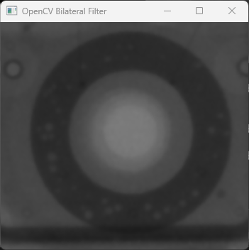
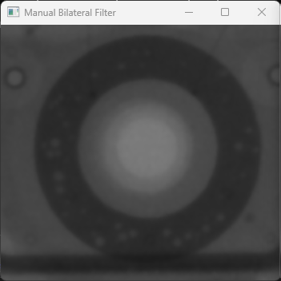

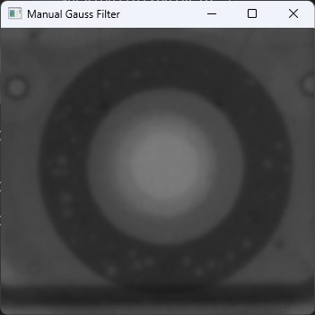
Bilateral Filter – Performance comparation
Blur (image 349 x 320) | Time
Bilateral Filter Opencv (kernel 9x9 sigma space = 15, sigma color = 75) | 1ms
Bilateral Filter My implementation (kernel 9x9 sigma space = 15, sigma color = 75) | 1590ms
Gaussian Filter Opencv (kernel 9x9 sigma space = 1.5) | 4ms
Gaussian Filter My implementation (kernel 9x9 sigma space = 1.5) | 18ms
Notes:
Here is a performance comparison table between the function I wrote and OpenCV's built-in function. The results show that my function performs significantly worse than OpenCV's, taking much more time to execute. A comparison of the two outputs (one from my function and one from OpenCV) is shown below: we can see that the results are quite similar.

